Slide 1
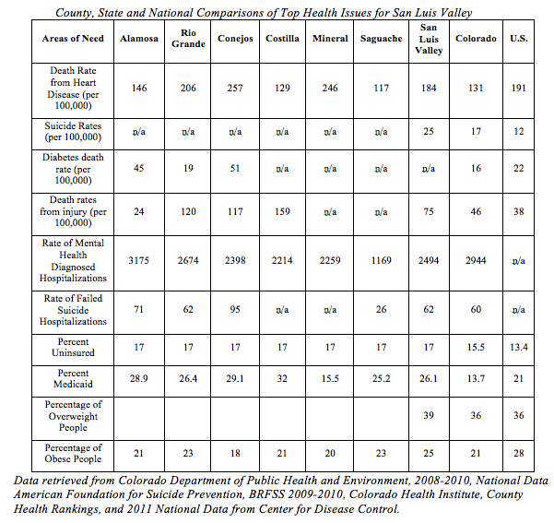

Slide 2
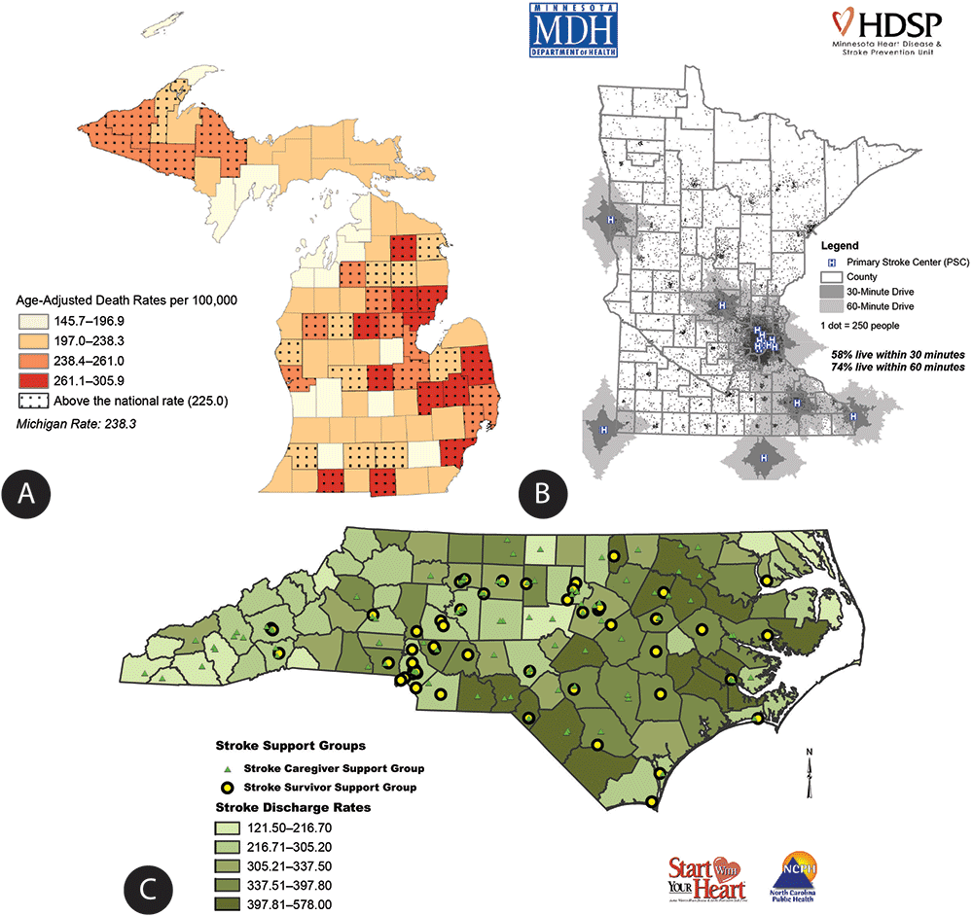
Presenting Data in Grant Proposals
Maps: helpful in providing spatial understanding
Good resolution, clear, to the point!
Must have a meaning, don’t use if it’s not warranted

Slide 3
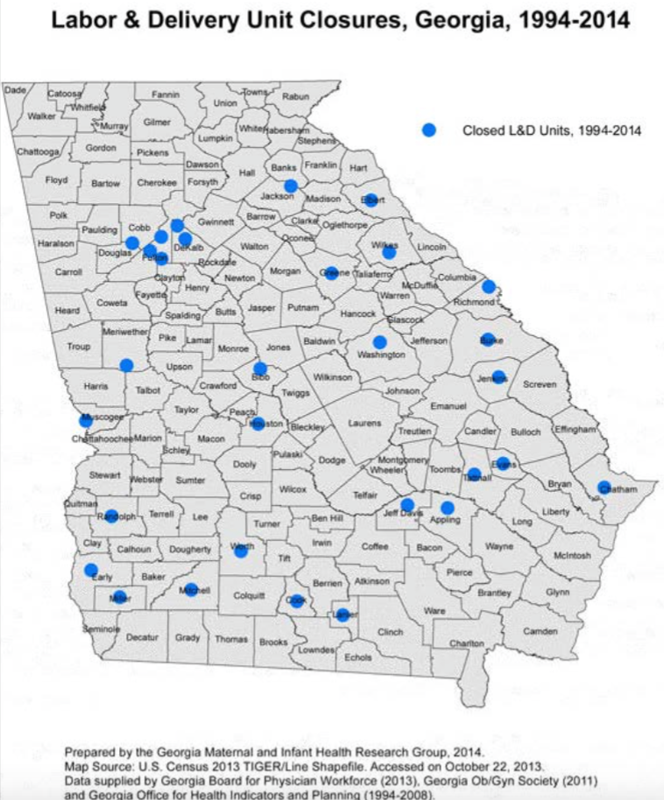
Example
Independent of individual and population- level risk factors, women in Georgia who drive more than 45 minutes to their hospital are more than 1.5 times as likely to deliver preterm as women who drive less than 15 minutes.
Women who delivered preterm (<37wks) lived an average of 40 minutes from their delivery facility
Women who delivered at term lived an average of 32 minutes from their facility
24% of women delivering singleton infants had to drive >45min to access obstetric services between 1999 and 2009

Slide 4
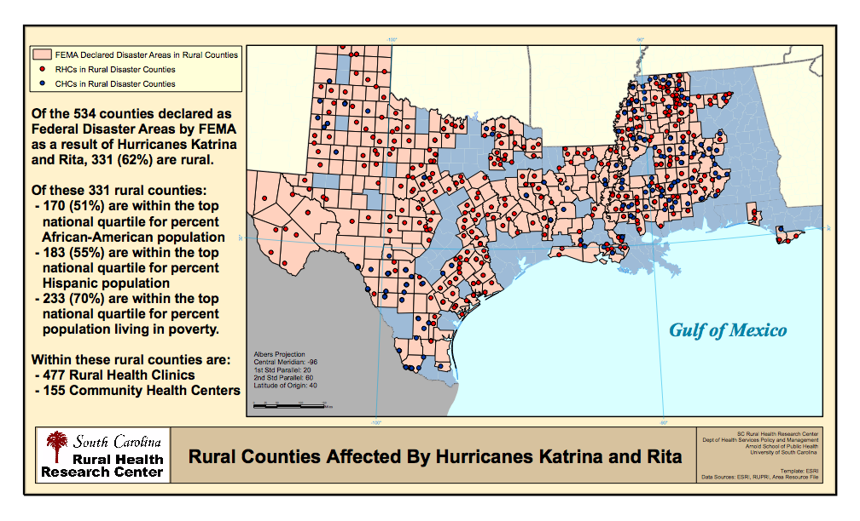
Proposed $10 Billion in Medicaid Cuts: And how would that have helped?
Notes:
In the aftermath, there was discussions of cutting Medicaid to help pay for the rebuilding of New Orleans.
While Katrina and Rita brought devastation to popular urban sites, the real victims (and their tragedies) were seen in rural, but their story wasn’t being told.
I can’t say with certainty that the map helped, but it did equip the right people with evidence when talking to policymakers.
I know you’ve had a session on using GIS, but the value of a picture, whether it be an image or a map, cannot be overemphasized.
So this was an innovative example of presenting data that told a story from a ‘triage’ perspective…what about ‘prevention?’ In South Carolina, we applied the Katrina scenario for our folks; specifically, policymakers and healthcare leaders.

Slide 5
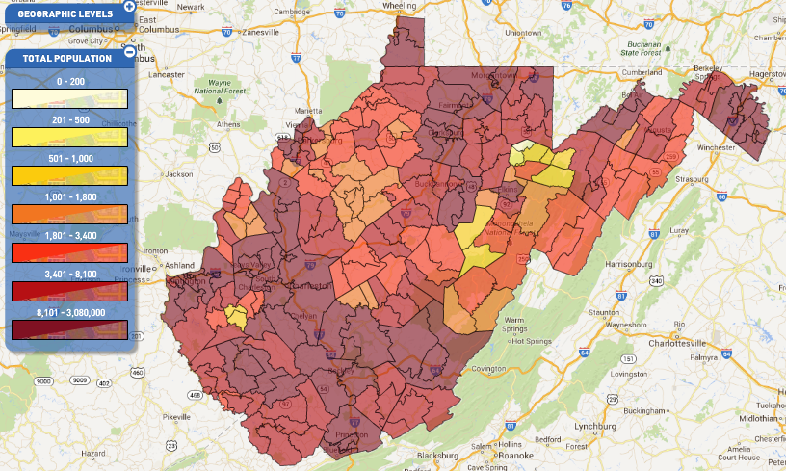
Using Census Data for Grant Writing
Tim Sarko
Data Dissemination Specialist for West Virginia
U.S. Census Bureau

Slide 6
Census Data Products Useful for
Writing Successful Grants
Census Data Profiles
2010 Summary File 1& 2 Data Sets
Narrative/Graphic Profiles
American Community Survey Detailed Tables
QuickFacts & QuickLinks
American FactFinder Data Tool

Slide 7
Census Data Profiles
Good place to start
Provide fact sheets on the social, economic, demographic, and housing characteristics for different geographic areas
About 450 different characteristics

Slide 8
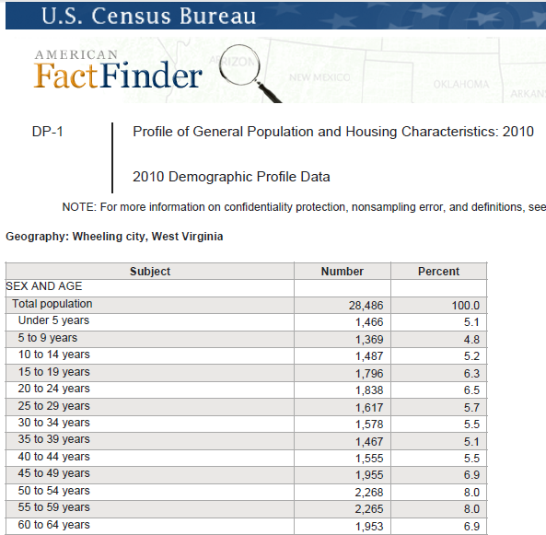
Demographic Profile DP-1
Notes:
DP-1 is from the 2010 census. It contains population by age and sex: Race & Hispanic origin: Relationship: Households by types: Housing Occupancy and Housing Tenure.

Slide 9
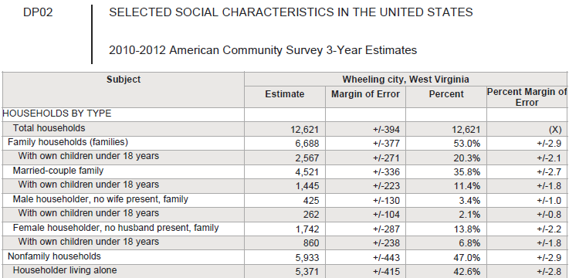
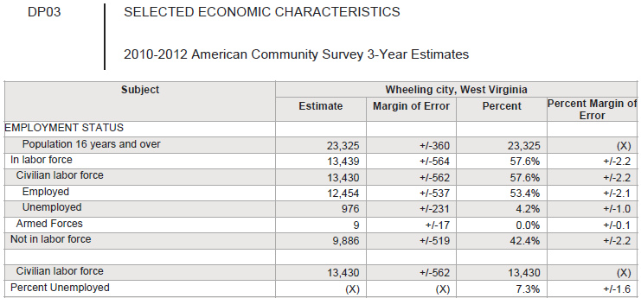
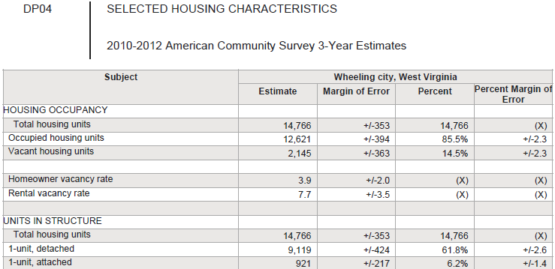
ACS DP-2, 3 & 4 (2012)

Slide 10
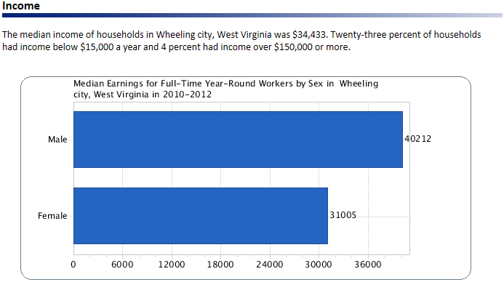
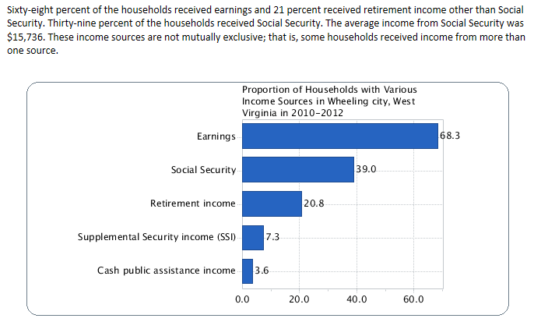
Narrative and Graphic Form (Population & Housing Narrative Profile ACS)

