Slide 1
National Cooperative of Health Networks Association, Inc.
Rebecca Davis, Ph.D.
Executive Director

Slide 2
Mission Statement
NCHN’s mission is to support and strengthen health networks.

Slide 3
Membership Profile
NCHN has a membership of:
  56 Networks
  8 Associate members
  1 Business Partners
  6 Strategic Partners
The large majority of the over 1,000 hospitals, clinics, nursing homes, community health centers, and other entities represented by the network members are rural.

Slide 4
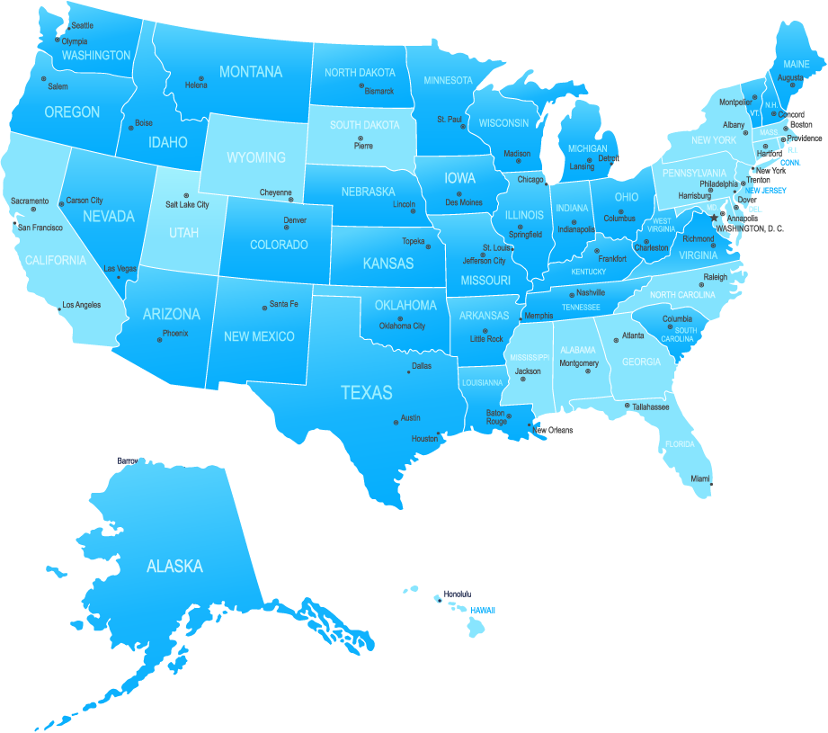
Membership Map
Dark blue indicates states with at least 1 NCHN member

Slide 5
Top 3 Benefits
(as rated by members)
Networking Opportunities
Annual Educational Conference
Newsletters and Informational Emails

Slide 6
Educational Calls
Quarterly Informational Calls
Member conference calls cover timely topics of relevance to health network leaders
ER for Health Network Leaders (Executive Roundtable Calls)
Members are invited to join the Executive Roundtable and participate via monthly calls facilitated by leadership and network expert Dr. Mary K. Chess

Slide 7
Electronic Resources
NCHN Listserv (comprised of network members)
Electronic newsletter (1st and 3rd Tuesday of each month)
Tools & Strategies for Managing Health Networks: www.NetworkTools.NCHN.org
NCHN website www.nchn.org – members are encouraged to complete their profile

Slide 8
Grant Coaching &
Review Service
This service provides coaching, critical review, and editing services to those NCHN member organizations that are working to submit and win federal grants.
Coaches are experienced in writing and securing federal grants.
Discounted Fee of $135/hr.

Slide 9
Other Benefits
Biennial Salary & Benefit Survey
Annual Awards
Referral to resources and other members for assistance
Promotion of networks & best practices at the national level
Rural Project Examples on RHIhub (Rural Health Information Hub) - http://www.raconline.org/success/project-examples/sources?source=National%20Cooperative%20of%20Health%20Networks%20%28NCHN%29

Slide 10
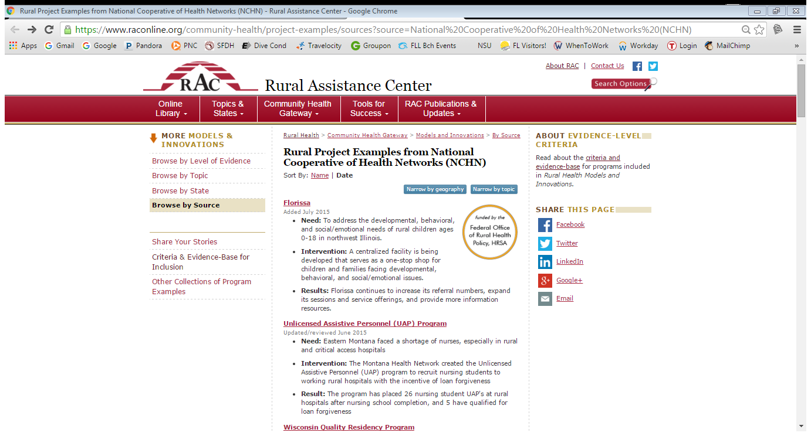
Success Stories

Slide 11

Upcoming Meetings
  2016 Annual Educational Conference
    April 18-21, 2016
    (Oklahoma City, OK)
    Wednesday, April 20, 2016 – Disney Institute Business Excellence Program
  2016 Leadership Summit
    October 2016
    Location – TBA

Slide 12
Disney’s Approach to Business Excellence
Creativity/innovation
Leadership excellence
Quality service
Brand loyalty
Selection, training, and engagement

Slide 13
Additional Benefits
Ongoing identification and development of programs and resources to support networks
Facilitation of collaboration among members and collaboration with other national entities (e.g., 3RNet, NARHC, NRHA, and NOSORH)

Slide 14
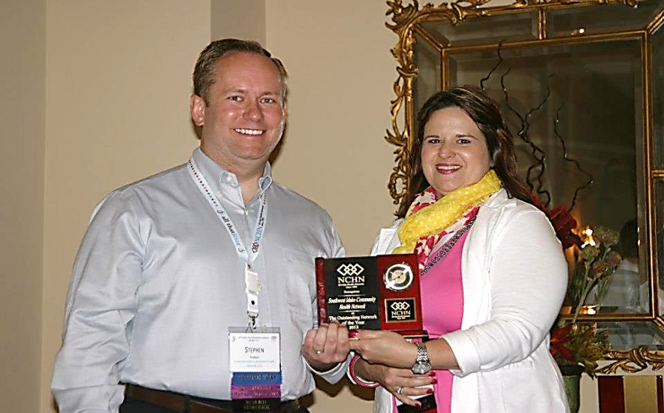
NCHN President
Stephen Stoddard, Executive Director of the New Mexico Rural Hospital Network

Slide 15
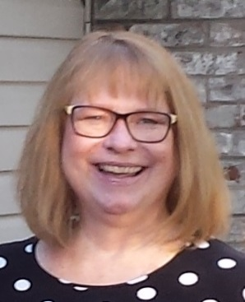


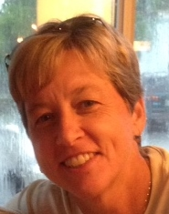
NCHN Staff
Rebecca Davis
Executive Director
rdavis@nchn.org
Tara Long
Administrative Assistant
tlong@nchn.org
Larry Bedell
Director of Sponsorships
lbedell@nchn.org
Linda K. Weiss
Director of Member Services
lweiss@nchn.org

Slide 16
For More Information, Contact:
Rebecca J. Davis, Ph.D., Executive Director
NCHN
400 South Main Street
Hardinsburg, KY 40143
Phone: 970-712-0732
E-mail: rdavis@nchn.org
Web site: www.nchn.org

