Slide 1
The Rural Health Care Program
SORH Region A

Slide 2
Agenda
Program Overview
HCF Program Overview
Telecom Program Overview
Resources Available
Information about your state!

Slide 3
Program Overview
Rural Health Care Program

Slide 4
USAC, the Universal Service Fund (USF), and the FCC
Program Overview
The Universal Service Administrative Company (USAC) administers the universal service fund (USF) on behalf of and under the auspices of the FCC.
Rural Health Care
Schools and Libraries
High Cost
Lifeline

Slide 5
What is the Universal Service Fund?
Program Overview
What is the Universal Service Fund (USF)?
The USF is money collected from telecommunications companies dedicated to fulfilling the universal service goals; and
Helps make telecom access available to all U.S. consumers
The FCC’s universal service programs provide support to:
High cost companies serving remote and rural areas (Connect America Fund);
Low-income consumers (Lifeline Program);
Health care providers (Rural Health Care Program); and
Schools and libraries (E-rate)

Slide 6
The USF and RHC
Program Overview
The Rural Health Care Program is allotted $400 million annually from the USF
Progress towards the annual cap

Slide 7
USAC and the FCC
Program Overview
The Federal Communications Commission (FCC), among other things, oversees USAC’s administration of the four Universal Service Programs, including the Rural Health Care Program.
The FCC’s functions and responsibilities include:
Establishing and modernizing the universal service programs in accordance with applicable statutory provisions;
Adopting and modifying program rules;
Issuing policy and rule guidance; and
Acting on appeals of USAC decisions.

Slide 8
USAC and the FCC
Program Overview
USAC’s functions and responsibilities include:
Administering each of the USF programs, including processing of applications;
Billing contributors, collecting, contributions, an disbursing universal service support;
Reporting quarterly to the FCC on disbursement of USF support; and
Estimating improper payments and conducting audits.

Slide 9
Three Rural Health Care Programs
Program Overview
Healthcare Connect Fund Program
Supports broadband connectivity and broadband networks for eligible HCP
Provides 65 percent discount on eligible services and equipment
Telecommunications Program
Funds urban/rural rate difference for telecommunications services for rural healthcare providers (HCPs)
Remains in place after Healthcare Connect Fund Program implementation
Pilot Program
Supports 50 state-wide and regional broadband HCP network (not open to new applicants)
Participants transition to Healthcare Connect Fund as Pilot funds are exhausted

Slide 10
Who is Eligible? Status
Program Overview
Nonprofit
OR
Public

Slide 11
Who is Eligible? Facility Type
Program Overview
Not-for-profit hospitals
Rural health clinics
Community mental health centers
Local health departments or agencies
Post-secondary educational institutions offering health care instruction, teaching hospitals, and medical schools
Community health centers or health centers providing health care to migrants
Dedicated emergency departments of rural for-profit hospitals
Part-time eligible entities
Consortia of the above entities

Slide 12
Who is Eligible? Location
Program Overview
Individual HCP applicants must be located in an FCC-approved rural location to be considered rural.
There is a rural look-up tool located on the USAC website: www.usac.org/rhc/telecommunications/tools/Rural/search/search.asp

Slide 13
My Portal
Program Overview
All RHC are forms filed online
Can have multiple account holders filing forms

Slide 14
Healthcare Connect Fund (HCF) Program Overview
Rural Health Care Program

Slide 15
Key Features of the HCF Program
HCF Program Overview
Support for broadband connectivity and broadband networks for eligible HCPs
Both consortium and individual HCPs may apply
35 percent HCP contribution required
Funding began January 1, 2014 (July 1, 2013, for existing Pilot projects)
Going forward, funding year will run from July 1st to June 30th
Covers both broadband services and HCP-owned infrastructure
Non-rural HCPs can participate if in majority-rural consortia
Multi-year funding commitments available to consortia
Connections to off-site administrative offices and data centers covered

Slide 16
Key Features of the HCF Program
HCF Program Overview
Administrative benefits include:
Flat-rate discount, which simplifies the calculation of discount level
Consortia can use a single application
Healthcare Connect Fund Program provides options:
HCPs can apply as individuals
HCPs can join an existing consortium, either now or after participating as an individual HCP in the HCF Program
HCPs also can band together and form a new consortium

Slide 17
Goals of the HCF Program
HCF Program Overview
FCC’s Performance Goals for Healthcare Connect Fund Program:
Increase access to broadband for HCPs, especially those serving rural areas
Foster development and deployment of broadband health care networks
Maximize cost-effectiveness of the program
FCC and USAC will collect data through the application process to help measure progress toward achieving these goals.
Consortia will also file annual reports regarding their use of broadband connections, including data on telemedicine, exchange of health information, and remote training.

Slide 18
Benefits of the Consortium Approach
HCF Program Overview
Creation and growth of broadband HCP networks
Lower administrative costs
Sharing of medical, administrative, and technical expertise
Lower prices, higher bandwidth, and better quality connections
Non-rural sites may participate in consortia and receive the discount, as long as they are in a consortium with a majority rural sites.
Consortia can include ineligible health care provider sites, who pay their “fair share” but can be part of the network and benefit from negotiated rates
Improved quality and reduced cost of healthcare through leveraging broadband connections in consortia

Slide 19
Application Process
HCF Program Overview
Determine Eligibility
Must meet the three initial program criteria and make sure requested services are eligible
Develop Evaluation Criteria and Request Services
Develop scoring criteria to evaluate bids and describe service needs (posted on USAC website)
Evaluate Bids & Select a Service Provider
Choose the “most cost-effective” service provider

Slide 20
Application Process
HCF Program Overview
4. Submit Funding Requests
Provide information about services and selected service provider
Invoice
Initiate invoicing process and submit to service provider for review

Slide 21
Four FCC Forms:
HCF Program Overview
FCC Form 460 – Registering and Determining Eligibility
FCC Form 461 – Requesting Services
FCC Form 462 – Requesting Funding Commitment
FCC Form 463 – Submitting Invoice

Slide 22
Four FCC Forms Processing Time:
HCF Program Overview
FCC Form 460 –Processing Time: 30 days
FCC Form 461 – Processing Time: Without RFP 3-5 business days. With RFP, approximately 4 weeks.
FCC Form 462 – Processing Time: 60-90 days
FCC Form 463 – Processing Time: 30 days

Slide 23
Four FCC Forms Processing Time:
HCF Program Overview
Processing time is calculated from the date of receipt of a complete and accurate form, including all supporting documentation.
Missing and inaccurate information will delay processing.
Timeliness of responses to USAC requests for information affects processing time (applicants are required to provide a response to information requests within 14 calendar days).

Slide 25
FCC Form 460: Eligibility and Registration Form
HCF Program Overview
Certifies that the applicant meets eligibility requirements
An individual applicant must file an FCC Form 460 for itself and a separate FCC Form 460 for any associated off-site administrative office or off-site data center.
Eligibility must be determined before an FCC Form 461 (Requests for Services Form) can be reviewed.
Includes site information, contact information, eligibility information, certifications and signatures

Slide 26
FCC Form 460: Who Must Submit
HCF Program Overview
All applicants requesting funding through the HCF Program
Every applicant must submit an FCC Form 460 even if the applicant has been deemed eligible to participate in another component of the RHC Program (Telecom or Pilot Program).

Slide 27
FCC Form 460: When to Submit
HCF Program Overview
The FCC Form 460 may be submitted at any time during the funding year.
The form only needs to be submitted once (as opposed to every funding year) to establish eligibility, unless there are information changes.

Slide 28
FCC Form 461: Request for Services Form
HCF Program Overview
Initiates the competitive bidding process,
Must be posted on USAC’s website for at least 28 days,
Provides information about requested services and network equipment to enable an effective competitive bidding process, and
Can be submitted starting 180 days before the beginning of the funding year.

Slide 29
FCC Form 461: Who Must Submit
HCF Program Overview
All applicants, unless their request for service meets one or more of the HCF Program competitive bidding exemptions.

Slide 30
FCC Form 461: Competitive Bidding Exemptions
HCF Program Overview
An annual undiscounted cost less than or equal to $10,000,
Purchasing from a government-negotiated Master Services Agreement (MSA).
MSAs approved under the Pilot Program or HCF Program,
Contracts negotiated under the E-rate Program (Schools and Libraries Program).
A multi-year contract deemed evergreen by USAC.

Slide 31
What is an Evergreen Contract?
HCF Program Overview
If USAC has designated a multi-year contract as evergreen, then for the life of the contract, applicants do not need to annually re-bid the service or post an FCC Form 461 (47 CFR, Section 54.642(h)(4)).

Slide 32
FCC Form 461: Choosing the Most Cost-Effective Bid
HCF Program Overview
All applicants must seek competitive bids for supported services.
All applicants must certify that they have selected the most cost-effective bid on their requests for funding (unless they qualify for a competitive bidding exemption).

Slide 33
FCC Form 462: Funding Request Form
HCF Program Overview
Provides USAC with information necessary to evaluate an applicant’s funding request
Applicants can seek a multi-year funding commitment
Applicants can file for multiple services on a single form

Slide 34
FCC Form 462: Who Must Submit
HCF Program Overview
All applicants requesting funding through the HCF Program

Slide 35
FCC Form 462: When to File
HCF Program Overview
Can be submitted as early as the 29th day after the FCC Form 461 posting (the Allowable Contract Selection Date or ACSD)
Must be submitted prior to 11:59 PM on June 30, the last day of the funding year

Slide 36
FCC Form 463: Invoice and Request for Disbursement
HCF Program Overview
Serves as a request to USAC for disbursement of funding from the HCF Program for services and equipment.
Filing the FCC Form 463 is a joint process between the applicant and service provider.
The applicant initiates the submission of the form and submits the form to the service provider who approves or rejects the form.

Slide 37
FCC Form 463: Invoice and Request for Disbursement
HCF Program Overview
The Invoice and Request for Disbursement Form may only be submitted after (cont’d):
The applicant has submitted its 35 percent contribution to the service provider, and
The service provider and applicant certify and sign the FCC Form 463.

Slide 38
FCC Form 463: When to Submit
HCF Program Overview
Can be submitted when the applicant’s FCC Form 462 has been approved and it has received a bill from the service provider (cannot submit for future service dates)
Applicants can submit FCC Forms 463 for individual or multiple months.
Must be submitted within six months of the end of the funding request.
Applicants must submit one form per funding request number (FRN).

Slide 39
Telecommunications Program Overview
RHC Program

Slide 40
Application Process
Telecom Program Overview
Determine Eligibility
Must meet the three initial program criteria and make sure requested services are eligible
Develop Evaluation Criteria and Request Services
Develop scoring criteria to evaluate bids and describe service needs (posted on USAC website)
Evaluate Bids & Select a Service Provider
Choose the “most cost-effective” service provider

Slide 41
Application Process
Telecom Program Overview
4. Submit Funding Requests
Provide information about services and selected service provider
5. Review, Approve, Submit
Review HCP support schedule and submit last application form certifying that the service was turned on and dates of service

Slide 42
Three FCC Forms
Telecom Program Overview
FCC Form 465 – Description of Services Requested and Certification Form
FCC Form 466 – Funding Request and Certification Form
FCC Form 467 – Connection Certification Form

Slide 43
Average Processing Time
Telecom Program Overview
FCC Form 465 – Three business days
FCC Form 466 – 150 business days
FCC Form 467 – One business day

Slide 44
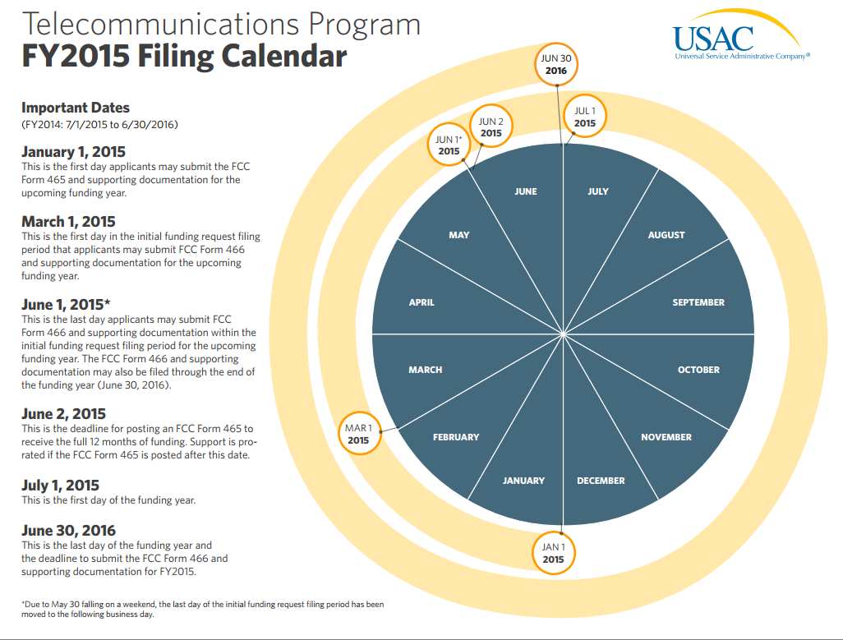
Three FCC Forms
Telecom Program Overview
FCC Form 465 – Description of Services Requested and Certification Form
FCC Form 466 – Funding Request and Certification Form
FCC Form 467 – Connection Certification Form

Slide 45
FCC Form 465
Telecom Program Overview
Eligibility, Registration and Request for Services Form
Eligibility must be determined before the FCC Form 465 can be posted
Initiates the competitive bidding process
Must be posted on USAC’s website for at least 28 days
Provides information about requested services to enable an effective competitive bidding process
Can be submitted starting 180 days before the beginning of the funding year

Slide 46
FCC Form 465: Who Must Submit
Telecom Program Overview
All applicants requesting funding through the Telecommunications Program who do not have an active evergreen contract (no evergreen contract or an evergreen contract that expiries or is modified during the funding year).
Every applicant must submit an FCC Form 465 even if the applicant has been deemed eligible to participate in another component of the RHC Program (Healthcare Connect Fund or Pilot Program).

Slide 47
FCC Form 465: When to Submit
Telecom Program Overview
Can be submitted as early as January 1 prior to the funding year. The form must be posted on USAC’s website for a minimum of 28 days before the applicant signs a new contract with a service provider.
To be eligible for a full 12 months of funding, submit in time for USAC to post by June 2 (28 days before the start of the funding year). Forms received later will be eligible for partial year funding.

Slide 48
FCC Form 466
Telecom Program Overview
Provides information about the service agreement and certifies that the applicant selected the most cost-effective offer.
USAC uses the information provided on this form to calculate and issues a funding decision.

Slide 49
FCC Form 466: Who Must Submit
Telecom Program Overview
All applicants requesting funding through the Telecommunications Program for each circuit for which funding is requested. (Note that multiple forms must be submitted if the services change or if the applicant moves to a new location.)

Slide 50
FCC Form 466: When to Submit
Telecom Program Overview
Can be submitted anytime in the funding year, but no earlier than the 29th day after the FCC Form 465 has been posted.
Must be submitted with all supporting documentation prior to 11:59PM on June 30, the last day of the funding year.

Slide 51
FCC Form 466: Other Requirements
Telecom Program Overview
If a form is received without all supporting documentation, or if supporting documentation is inadequate, USAC will inform the applicant in writing and give the applicant 14 calendar days to submit the missing or relevant supporting documentation.
If an applicant does not provide a timely response to USAC requests for documentation, the funding request may be denied.

Slide 52
FCC Form 467
Telecom Program Overview
Confirms service start and end dates or notifies USAC that a service was never turned on.
All applicants must submit one FCC Form 467 for each FCC Form 466.

Slide 53
FCC Form 467: When to Submit
Telecom Program Overview
Must be submitted after an applicant has received a funding commitment letter (FCL), and verified that the funding information on the FCL is correct.
Service dates may be edited on this form to reflect delayed installation or early termination of the service.
Service providers are strongly encouraged to review funding commitment letter with the applicant before the Form 467 is submitted.

Slide 54
Invoicing in the Telecom Program
Telecom Program Overview
The service provider completes the invoicing process in the telecom program.
Once the service provider has received and reviewed the HCP Support Schedule (HSS), the service provider should credit the applicant's account, then log in to My Portal and submit an online invoice to USAC.
After the online invoice is submitted, it will be processed within 24 hours.

Slide 55
Resources Available
Rural Health Care Program

Slide 56
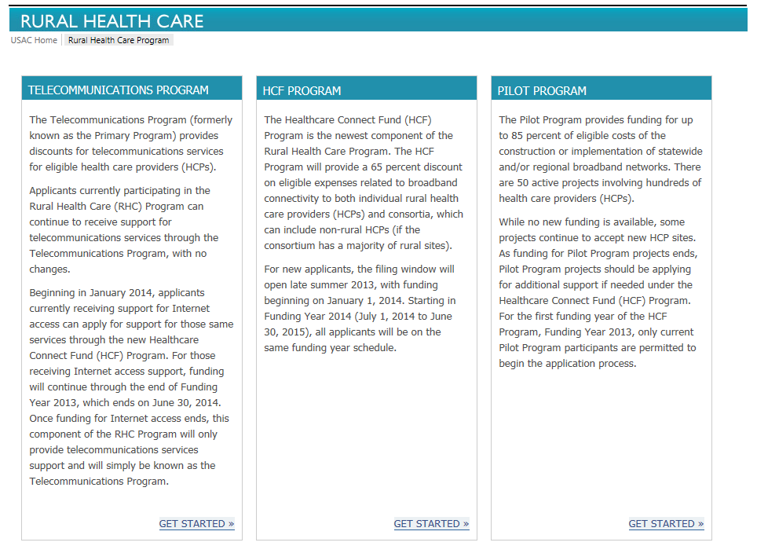
Resources Available

Slide 57
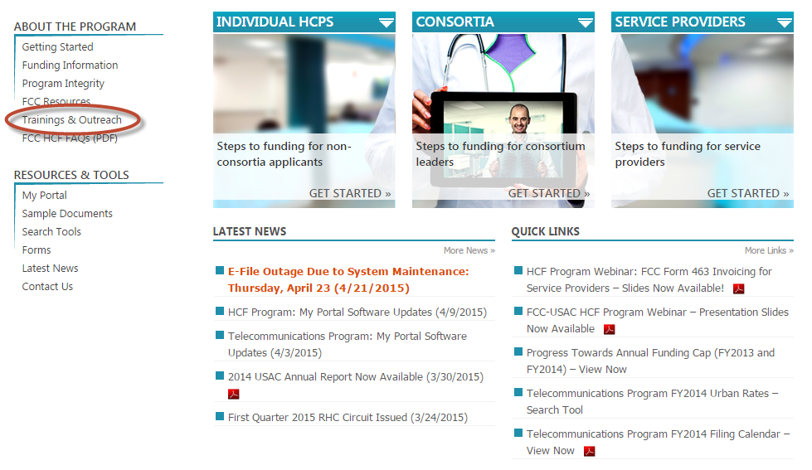
Resources Available

Slide 58
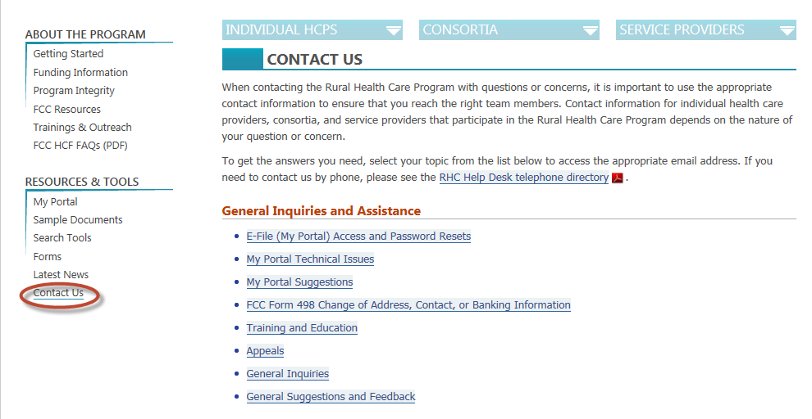
Resources Available

Slide 59
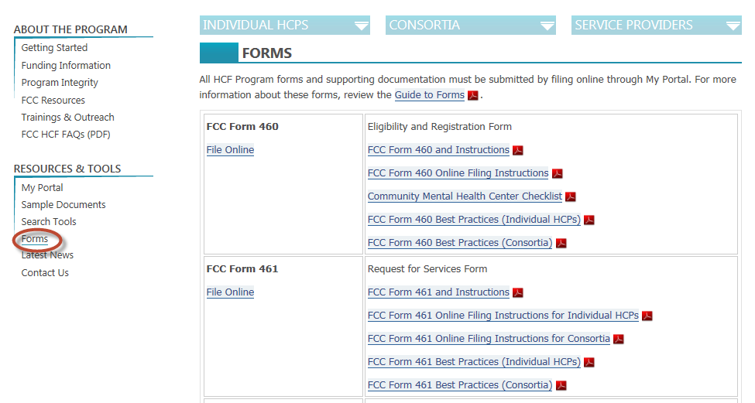
Resources Available

Slide 60
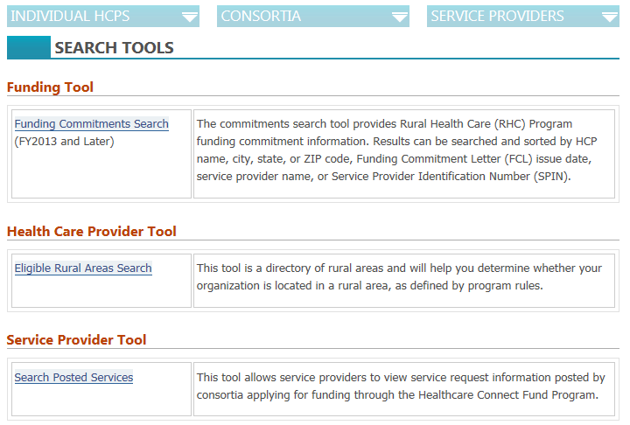
Resources Available

Slide 61
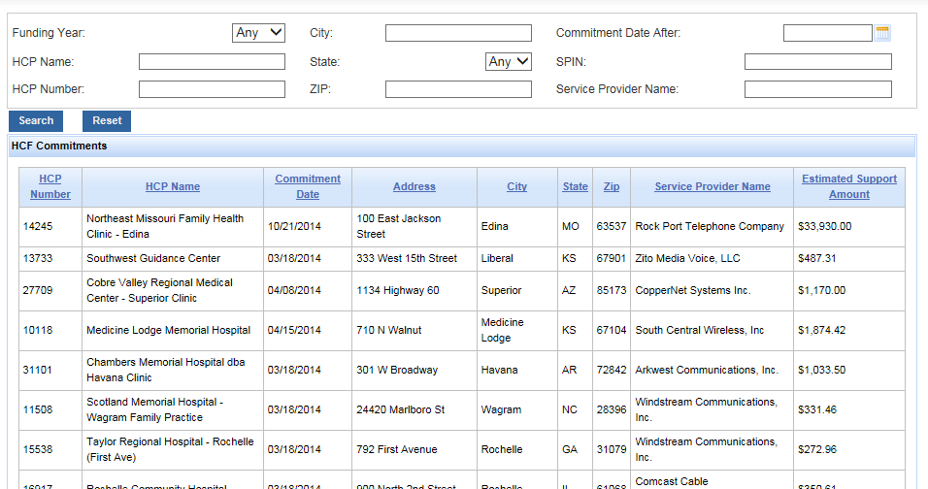
Resources Available

Slide 62
Other Resources
Resources Available
Webinars
RHC Circuit
RHC Events Calendar Coming Soon

Slide 63
Information about your State!
RHC Program Overview

Slide 64
Connecticut Consortia
State Information
Medical Professional Services Foundation, Inc.
American Healthcare Connect Consortium, Inc.

Slide 65
Maine Consortia
State Information
New England Telehealth Consortium (NETC) (Multi-state commitment)
Rural Western and Central Maine Broadband Initiative
Health Information Connectivity-Knowledge Rural Consortium
NMMC-CONSORT

Slide 66
Maryland Consortia
State Information
Indian Health Service
Delmarva Pediatric Healthcare Consortium (Multi-state commitment)

Slide 67
Massachusetts Consortia
State Information
New England Telehealth Consortium(Multi-state commitment
Oregon Health Network (Multi-state commitment)
Berkshire Health Systems
Hillcrest Dental Care Inc.

Slide 68
New Hampshire Consortia
State Information
New England Telehealth Consortium

Slide 69
New York Consortia
State Information
Adirondack-Champlain Telemedicine Network
North Country Telemedicine Project
Western New York Rural Area Health Education Center
NY Community Broadband Partnership
Columbia Memorial Hospital
Health Alliance of the Hudson Valley
St. Mary’s Healthcare
Hudson River Healthcare, Inc.

Slide 70
New York
State Information
Success Story: Adirondack-Champlain Telemedicine Network
The WAN that is available today simply did not, nor could have been implemented years ago. It is through Universal Service funding, that service providers have been willing to build out the infrastructure that is in place today and allows for the improved access to health care services.

Slide 71
Pennsylvania Consortia
State Information
Geisinger Health System
Northeast HealthNet
Northwestern Pennsylvania Telemedicine Initiative
Pennsylvania Mountains Healthcare Alliance
Sentara Healthcare Consortium(Multi-state commitment
The Primary Health Network
Jersey Shore Hospital

Slide 72
Pennsylvania
State Information
Success Story: Geisinger Health System
A neurologist working at a hospital in Geisinger, pointed out that through tele-stroke, patients in outlying rural communities have access to neurological consults within five to ten minutes as opposed to hours.

Slide 73
Vermont Consortia
State Information
New England Telehealth Consortium (Multi-state commitment)

Slide 74
Virginia Consortia
State Information
Virginia Acute Stroke Telehealth Project
Sentara Healthcare Consortium(Multi-state commitment)
Delmarva Pediatric Healthcare Consortium(Multi-state commitment)
Wellmont Consortium(Multi-state commitment)

Slide 75
Virginia
State Information
Success Story: VAST
The online journal for billing transactions has saved the system about 50 full time equivalent positions for a tremendous cost savings.

Slide 76
States without consortia
State Information
Rhode Island
New Jersey
Delaware

Slide 77
Questions?

Slide 78
Contact Us!
Rural Health Care Program
(800) 453-1546
RHC-Assist@usac.org

