Slide 1
Strategies for Addressing Primary Care Physician Workforce Shortages in Rural America
Tuesday, October 14th
3:00 – 4:00 PM (Eastern Time)
State Offices of Rural Health, State Rural Health Associations and other invited guests
David Schmitz, MD
RTT Program Director/Chief Rural Officer, Family Medicine Residency of Idaho
Randy Longenecker, MD
Assistant Dean, Rural & Underserved Programs and Professor of Family Medicine, Ohio University

Slide 2
RTT Technical Assistance Program “A consortium of organizations and individuals committed to sustaining RTTs as a strategy in rural medical education”
Office of Rural Health Policy
http://www.raconline.org/rtt/

Slide 3
Objectives
Learn about osteopathic and allopathic primary care physician residency training
Discuss the current status of rural family physician workforce
Understand the role residency programs play in providing physicians in rural American
Learn how State Offices of Rural Health and State Rural Health Associations can support residency programs

Slide 4
Osteopathic and allopathic primary care physician residency training
Pre-med (“before Medical School”)
Role of SORHs, SRHAs, AHECs and other partners
Medical students
Allopathic
Osteopathic
Resident training
Allopathic
RTTs (1-2 as the exception)
Osteopathic
RTTs (new designation)
Early career physicians
May need mentoring and support
May have young families/dynamic lifestyles
May be connected to teaching and proximal workforce recruitment

Slide 5
Are There Differences?
Medical Student training
Supervised patient care
No orders without co-signature
May scribe some aspects of medical record
Resident training
Supervised patient care with more autonomy
Orders and some prescribing without co-signature
Some notes independent, some with co-signature
Own panel of patients if in a rural continuity setting (e.g. RTT)

Slide 6
What Difference Does it Make?
Rural Training Tracks (Family Medicine)
At least 24 months in the rural place
Continuity of patient care (panel/clinic/PCMH)
Rural Rotations
Variable time in the rural place
Variable longitudinal/continuity experience
Rural Recruitment (Interview Days)
Variable exposure/relationships (bi-directional)

Slide 7
Discuss the current status of rural family physician workforce
What is the “state” of your state?
How is this assessed?
How is this communicated?
Who are the stakeholders?
How are teams formed?
How are strategies decided?
Who is executing the plan?
How are outcomes measured?

Slide 8
RTTs as a Proven Strategy
At least half of RTT Graduates were located in rural areas after graduation; at least two to three times the proportion of Family Medicine graduates overall
High proportions of RTT graduates provided healthcare in designated shortage areas, in safety net facilities and in underserved areas

Slide 9
RTT TA: The Evidence for RTTs

Slide 10
NOSORH and the RTT TA Project
Where are the RTTs presently and where are they developing?
How can we all be involved in sustaining existing RTTs and in supporting new RTT development?
How can we help medical students appreciate the opportunities RTTs offer for residency training and preparation for practice?

Slide 11
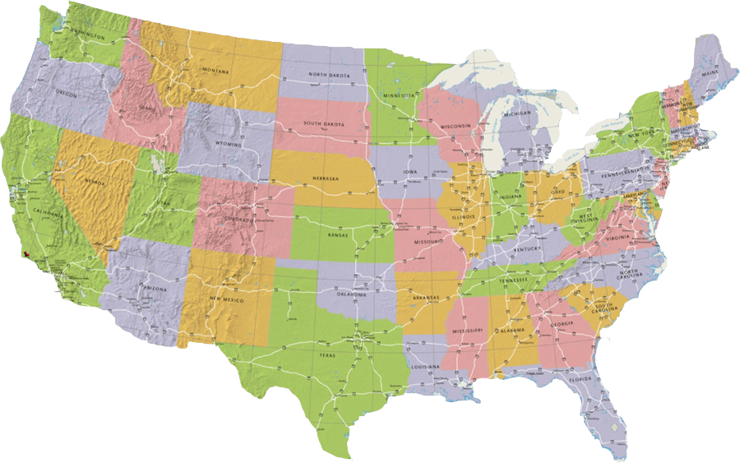
29 (36) Active 1-2 RTTs as of August 2014
Active 1-2 RTTs
1-2 like RTTs
*RTT Technical Assistance Program – Updated 8-13-2014, Randall Longenecker, Senior Project Advisor

Slide 12
28 (35) Active 1-2 RTTs as of August 2014
(plus developing programs)
Active 1-2 RTTs
1-2 like RTTs
Developing RTTs
*RTT Technical Assistance Program – Updated 8-11-2014, Randall Longenecker, Senior Project Advisor

Slide 13
The role residency programs play in providing physicians in rural American
The right people
Where do they come from
Why do they come here
How do they fit in and settle
With the right skills
Curriculum and mentorship
Competence and confidence
In the right places
“Train to Remain” is “Recruitention”

Slide 14
Learn how State Offices of Rural Health and State Rural Health Associations can support residency programs
What are SORHs and SRHAs doing or have you done in this area?
Are there practices or ways that SORHs and SRHAs can learn from each other?
What support or resources might SORHs and SRHAs need in the efforts?

Slide 15
Best Practices (and Addressing Tough Challenges)
Examples of what works:
Examples of obstacles or barriers in what ought to work well (but hasn’t so far):

Slide 16
Next Steps and Taking it Forward
“RTTs: What SORHs Need to Know”
What we all need to know to be working together…
NOSORH Annual Meeting: October 28th 1:30pm
We will present comments that participants at the 2014 RTT Conclave made about challenges and opportunities for supporting rural GME
Comments from this NOSORH webinar will also be shared for further discussion and follow up

Slide 17
Questions and Comments

