Slide 1


The Inside Scoop on the Community-Based Division-Now and Moving Forward

Slide 2
CBD Programs and Priorities
Programs:
  330a of Public Health Service Act (PHS)
    Rural Health Outreach
    Rural Network Development
    Rural Network Planning
    Quality Improvement
    Delta States Program
    Rural Workforce Development (pilot)
    Rural HIT (pilot)
    Rural HIT/Workforce (pilot)
  Black Lung & Radiation Exposure Screening Education
  Rural Access Emergency Devices (RAED) and Public Access to Defibrillator Demonstration Program (PADDP)
2014 Focus:
  Continue Evidence-Based Approach
  Push for Sustainability
  Measure Performance/showing impact
  Telling our story
Community Need
Funding
Performance Data/Outcomes
Sustainability
Build the Rural Evidence Base
Notes:
-14 staff, 11 grant program
-programs under 330a go directly to rural communities to focus on service delivery, infrastructure development, quality improvement activities.
-appropriation amount per year-grants, contracts (TA), evaluation, among other activities
-flexible authorization allowing us to address needs as they arise (pilot programs)
-Other programs on cbd
-2014 focus and new approach with programs leading to SORH engagement (more webinars, orientation to new approach, etc.)

Slide 3
Community Health
Community Need
Evidence-Based
Demonstrate value
Act as a “catalyst”
Sustainability
Community Health Gateway
Notes:
1st point: Evidence-based
So, Tom talked about some emerging issues and challenges earlier and we are trying to address some of those challenges….
As some of you may know, we have changed the approach of some of our community-based programs to be more evidence-based and outcomes oriented approach.
The impetus for this change was that programs that we had in the past were not based on e-b or promising practice and we are constantly reinventing the wheel because projects proposed has not shown potential impact…and therefore some could not be sustainable or has failed. And we could not show value with this old approach
Again, this way, rural is not reinventing the wheel…if there’s something out there that works, then let’s use that
2nd point: Value, catalyst and sustainable
All of our community-based programs are demonstration projects. Because of this, we strive for these programs to be able to show VALUE in their projects which can obviously lead to sustainability (very fitting for a demonstration project)
So can we show value so far????
We’ve realized value in some of our health services programs—Outreach, Quality and Workforce.
The first program to go through this new evidence-based approach is our Outreach Program (biggest program due to non-categorical nature etc.)…it is a 3-year program so we’re hoping that we will be able to uncover good outcomes and data when this cohort ends next year (2015).
The value that we’ve realized is that a lot of our programs act as catalysts to do bigger and better things (again, very fitting of a demonstration program)…
our Network Planning program—main purpose is to “bring people to the table” to eventually provide services in their communities. Because this is a planning grant, collaboration is a vital factor to be successful and we all know that that is challenging to quantify (how do you measure collaboration???).
But, we have found that this program has acted as a catalyst for these networks or partnerships to evolve and mature eventually addressing challenges that Tom talked about earlier…
For example, one of our grantees are planning on focusing on interdisciplinary workforce program
And to further elaborate on this point, I want to show you some data from our programs acting as “catalysts” in their communities
Next slide:
For example, for our Quality Program (implement QI strategies)—Chataqua and Kodiak..Also, show quality data on HbA1c
Also, Show workforce program data
3rd point: Community Health Gateway
So, with all that we’re doing with evidence-based and demonstrating value, we’ve developed the Community Health Gateway. Explain what it is

Slide 4
Key Highlights of 2014
New Awards for Network Planning, Network Development, RESEP , Black Lung, RAED & PADDP Programs
Outreach, Quality and Delta Program supplements for ACA Outreach & Enrollment Efforts
Pilot Programs: Rural HIT Network Lessons Learned
Continue to see sustainability data increase
Expansion of the Rural Community Health Gateway & Evidence-Based Work
Network Planning: 71
Network Development: 54
Black Lung: 15
ACA Outreach, Education and Enrollment Supplements
  Focus on outreach, education & enrollment
  Up to $25,000K per grantee
  http://www.hrsa.gov/ruralhealth/about/community/index.html
Notes:
-busy fiscal year, but such a good one for rural programs
-high visibility on the new HIT/WF program. WHRC did a blog, department did press release
-high visibility on the O&E supplements-very excited to do this and goes back to our fortunate we are having a broad, flexible authority to do activities like this that are needed. Opened to 71 OR grantees and 52 came in and received it. Up to $25K for the year to focus on O&E. Tracking data, and holding series of webinars. Many applying for CAC designation. Also have current grantees received navigator awards:
Network Planning & Development: Affiliated Service Providers of Indiana, Inc. (IN)
Outreach: Bi-State Primary Care Association (NH)
Delta States: Tombigbee Healthcare Authority (AL)
HIT Program: Little Dixie Community Action Agency, Inc. (OK)
HIT Program: Alaska Native Tribal Health Consortium (AK)
Outreach grantee (not the lead applicant but part of the application)
Mariposa Community Health Center is part of two CMS Navigator applications: one awarded to the Arizona Alliance for Community Health Centers and one awarded to the National Healthy Start Association.

Slide 5
Community Health
Chautaqua County Health Network
Diabetes 2011-2013
Quality Program funding
Network
Clinical Integration
Quality Program Funding
ACO
Notes:
Chautaqua
As a result of the Quality grant:
catalyst for provider network to work together as never before on quality improvement
enabled grantee to build capacity to move closer to clinical integration
participate in the Medicare Shared Savings Program (ACO)
And to hone down on the point of demonstrating value---
Data around Diabetes reported for the 3 years of this program
So, we compared our program data to the National data—national data came from National Committee for Quality Assurance (NCQA), most comparable to HRSA grantees/safety net
Hard to find data that is exactly comparable to the measures we are using – apples to apples comparison
For the most part, we are doing better than the national average and I just want to highlight our HbA1C data
As you can see, the % of patients that have HbA1C lower than 8 are reported to be higher through our program..so the patients that our grantees serve, their Diabetes is better controlled.

Slide 6


Economic Impact
$1.63 generated for every HRSA $1
~$19.4 Million generated for ~$11.9 Million HRSA investment
Notes:
As part of the rural health initiative, we developed a workforce program about 4 years ago
And again, to elaborate the point of acting as a catalyst and demonstrating value—we’ve found that the economic impact of this program is that $1.63 is generated for every HRSA dollar invested. So, to put that on a aggregate scale, that means that $19.4M is generated for about $11.9M HRSA investment…and for those of you who are not familiar with our economic impact tool that we use—this tool accounts for jobs created, money recycled back into the community as a result of HRSA funding.

Slide 7
Expansion of the Rural Community Health Gateway
5 toolkits launched (CHW, obesity, mental health, care coordination and oral health)
Future toolkits: Health promotion and Disease prevention
Sustainability guide and economic impact tools are available
Launch of The Rural Health Models and Innovations Hub
Notes:
-priority of the presidents rural health initiative to build an evidence-based gateway (identify models that have a “level of evidence”)-can be adapted and replicable and impactful
-helping to read the way in rural
-aligns with office priorities and program new approach
-allows communities to not have to reinvent the wheel-information is there.

Slide 8

How Will You Sustain Your Program?
Sustainability Primer
  contains information and opportunities for reflection and discussion appropriate for consideration at the initial stage of program implementation.
  http://www.raconline.org/sustainability/
Notes:
Very large part of our TA process.
-outreach (98%) network d. (87%)-all or parts of program/network sustained
-high % on network member fees, in-kind, reimbursable services
-emphasis from day 1 on the framework developed by GSU for OR, NWD, Delta
-focus on leadership, collaboration, strategic planning, business planning, vision, etc.
-materials on gateway for other rural communities to utilize and this has helped us build our rural EVB

Slide 9
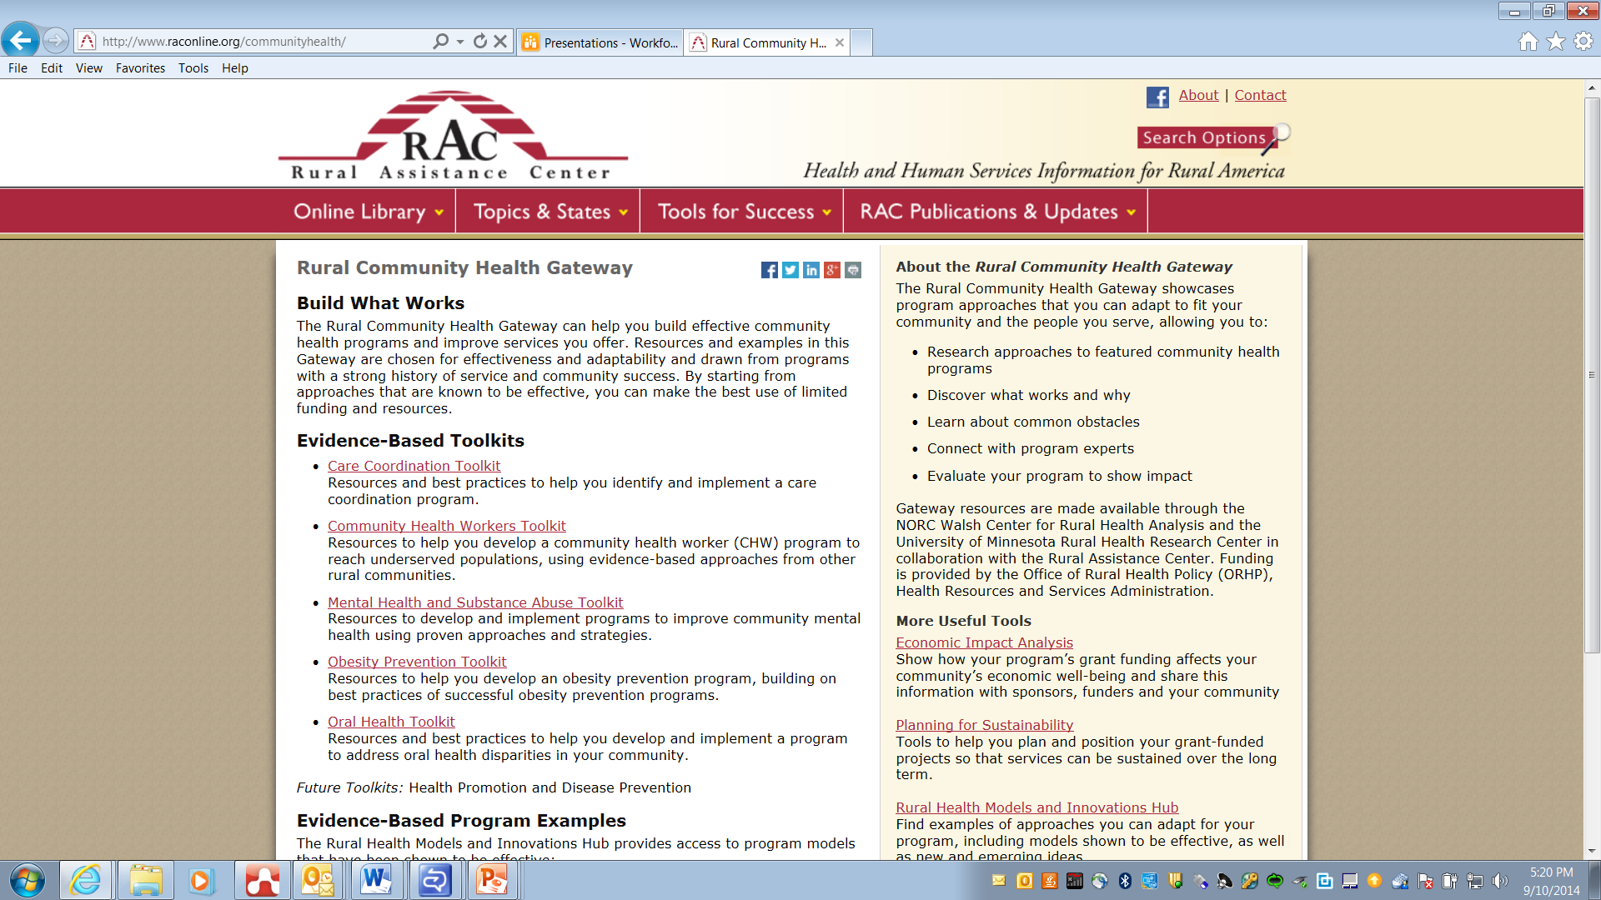
Notes:
Internet connection to page

Slide 10
State Office of Rural Health Role
SORH language under Section 330a PHS Act:
  “To be eligible to receive a grant, an eligible entity, in consultation with the appropriate SORH or another State entity, shall prepare and submit to the Secretary an application…”
SORH language in 330a program funding opportunity announcements (FOA):
  Applicants are required to notify the State Office of Rural Health (SORH) of their intent to apply to this program.
  Applicants must include a copy of the letter or email sent to the SORH, and any response to the letter that has been received, that was submitted to the SORH describing their project
Notes:
-targeted webinars and messages to the SORHs
-encourage you to reach out to our 330a new grantees when awards are released
-orhp plans to be in more contact with sorhs as grants go on-as we do site visits, issues arise- what resources do you have for the grantee?
-allow for an opportunity for you to participate on grantee webinars-series of webinars now that face-face going away.

Slide 11
Looking Ahead to 2015…
Competitive Funding Opportunities
  Rural Health Care Services Outreach Program
    Funding Opportunity recently released: HRSA-15-039
  Rural Network Planning Program
    Funding Opportunity Release Date: November 2014
Help us spread all the good work rural communities are doing!

Slide 12
Questions and/or Comments?

Slide 13
Contact Information:
Nisha Patel
npatel@hrsa.gov; 301-443-6894
Kathryn Umali
kumali@hrsa.gov; 301-443-7444
ORHP main line: 301-443-0835

